Slide 1
December 7th, 2021
Bonds 101:
Presentation to Black Butte School District
Long Range Facilities Planning Meeting
Carol Samuels
Managing Director
Piper Sandler

Slide 2
What is a General Obligation Bond?
  “Bonds” are loans that are broken into pieces and sold to investors.
  “General Obligation Bonds” are secured by property taxes and District’s “full faith and credit”.
  Debt service is repaid by property tax levy on all properties within District.
  GO Bonds are considered to be the highest quality credit a school district can offer to market.
  Interest on GO bonds is generally exempt from both federal and state income taxes, so rate is lower.

Slide 3
GO Bonds in Oregon
Tax levy is not limited by Measure 5 or Measure 50.
4 election dates: March, May, September, November. November and May are not subject to double majority.
Districts may have no more than 7.95% of RMV outstanding. This is usually a REALLY big number. For Black Butte RMV in 2022 is $253,385,256. The limit is $20,144,128.
Ballot title needs “not-to-exceed” amount, permitted use of proceeds and maximum years to maturity.

Slide 4
Use of Proceeds
Proceeds may be used for “capital construction and improvements” with a useful life of 1 year or more.
“Weighted average life” of bonds may not exceed “weighted average life” of projects.
“Routine” maintenance and supplies are not eligible.
Any interest earnings on proceeds must be used in accordance with ballot title.
Land and other assets | Acquisition | Construction | Improvements
Remodeling | Furnishing & Equipping | Maintenance or Repair

Slide 5
Federal Legal Rules
      Tax-exempt bonds are subject to federal tax law. Key provisions:
      Use of Proceeds
          Public purpose projects are OK
          Certain limitations on ‘partnerships,’ (e.g. non-profits)
      Reimbursement of past expenditures allowed during a limited period with approval of a reimbursement resolution
      Timing of Spending Proceeds:
          Issuer must have ‘reasonable expectation’ it will spend 85% of the proceeds in 3 years
          Includes any premium on proceeds
        SEC Rule 15C2-12 requires issuers to provide bond holders annual financial information.

Slide 6
Calculating the Bond Levy Rate
Debt service is payable from a dedicated property tax levy in addition to operating levy.
Levy rate is calculated annually by the County Assessor:
Districts CANNOT guarantee a rate; actual rate paid will depend on AV in future.
$950,000 + 50,000
Debt Service Due + Delinquencies
= Bond Levy Rate
= $1.00
= $0.50
(District Assessed Value/1,000)
($1 billion /1,000)
($2 billion/1,000)
($500 million/1,000)

Slide 7
Bond Levy Structure Options
Things to think about:
Length of Issue
Useful life of financed items?
Annual vs overall cost
Specific community priorities
Levy Impact
Focus on single issue or combined debt burden?
Future debt plans?

Slide 8
Bond Levy Structure Options, Continued
Astoria School District No. 1 – November 2018 election - $70M
Ballot Title:
“The State will provide a $4,000,000 matching grant if voters approve the bonds. If voters do not approve the bonds, the grant will be diverted to another school district.”
“With expiring 2000 bond, the estimated increase in tax rate is $1.00 per $1,000 of assessed property value over the current rate. Actual levy rate may differ due to actual interest rates and/or changes in assessed value.”

Slide 9
Bond Levy Structure Options, Continued
Winston-Dillard SD No. 116 – May 2019 election - $16.725M
Ballot Title:
“The State awarded Winston-Dillard School District No. 116 a $3,276,397 matching grant if the bonds are approved. The District is first on the waiting list to receive an additional $723,603, bringing total grant to $4 million. If bonds are not approved, grant funds will be distributed to another district.”
“Bonds would mature within 21 years from date of issuance. If approved, the bond tax rate is estimated to be $1.45 per $1,000 of assessed value, a reduction of $0.05 per thousand from the average rate of existing bonds which will be paid off in 2020. Actual tax rates may differ depending on interest rates incurred and changes in assessed value.”

Slide 10
Bond Levy Structure Options, Continued
North Lake School District No. 14 – May 2019 election - $5M
Ballot Title:
“North Lake School District No. 14 was awarded $3,000,000 in State grants which are available only if bonds are approved. District is also first on waiting list for additional $1,000,000 State grant; if full $4,000,000 State funds are received by District, only $4,000,000 in bonds will be issued.”
“Bonds would mature in 20 years or less from the date of issuance and may be issued in one or more series. If approved, the tax rate on $5,000,000 bond is estimated to be $1.37 per $1,000.00 of assessed value, or on $4,000,000 bond is estimated to be $1.09 per $1,000.00 of assessed value. Actual rates may vary based upon interest rates incurred and changes in assessed value.”

Slide 11
Election Schedule
Note: Dates associated with future elections are preliminary, subject to change.
Check with your County elections office to verify filing deadlines.
All elections are by mail.
SEL Form 805 includes ballot title, and may include explanatory statement. Must be filed 80 days prior to election to allow for challenge process. Final filing is 61 days prior to election (SEL Form 803).
Subject to double majority provisions.

Slide 12
What are your odds?
56.9% of Oregon school district GO bond issues from May 2010 to November 2019 have been approved.

Slide 13
Improving your odds: OSCIM program
Program provides State matching funds for SD GO Bonds.
Originally approved in 2015; reauthorized for 2021-23 at $142.2m, or $35.6m per election.
Min grant = lesser of $4m or SD bond amount. Max grant = $8m. Formula based on property value per ADMw and poverty statistics sets exact amount.
60% of funds are allocated in rank order based on property value and poverty. 40% is allocated by lottery (‘First in Time’). Of 197 school districts in Oregon Black Butte is 192nd on the priority list.
Applications are typically due 9 months prior to election.
Can only apply for elections in November and May.
ODE also requires facility assessment and plan to be submitted 2 weeks prior to application due date. TAP grants available.

Slide 14
OSCIM/Facility Plan Schedule
OSCIM Match at 4 elections.
Final May election amounts will be adjusted with any funds remaining from preceding November election.
District cannot apply for 2nd election until after 1st election occurs (e.g. District applying in July for November cannot apply again in December for May election).
Election Date | Facility Plan Due | Application Due
May elections | December 1 | December 15
November elections | July 1 | July 15

Slide 15
OSCIM Program History
Election: | May 2016 | Nov. 2016 | May 2017 | Nov. 2017 | May 2018 | Nov. 2018 | May 2019 | Nov. 2019 | May 2020 | Nov. 2020 | May 2021 | Nov. 2021
Applicants | 29 | 29 | 24 | 6 | 10 | 9 | 10 | 5 | 5 | 13 | 10 | 5
Recipients | 16 | 11 | 8 | 6 | 5 | 6 | 7 | 4 | 2 | 10 | 4 | 3
Amount Awarded | $53 m | $42 m | $31 m | $25 m | $25 m | $26.7 m | $23m | $27.7m | $12.2m | $15.9m | $16m | $12m
% Approval* | 50% | 45% | 75% | 100% | 60% | 83% | 100% | 80% | 40% | 79% | 50% | 60%
* Denotes approval rate for districts awarded grants prior to the election

Slide 16

GO Bond Sale Process
Bond Sales generally take 60-90 days from start to finish.
Bond Election | Adopt Bond Resolution | Begin Disclosure Docs | Rating Presentation | Bond Sale | Prepare Closing Docs
12 Weeks Pre- Closing | 10 Weeks Pre-Closing | 10 Weeks Pre- Closing | 5 Weeks Pre-Closing | 2 Weeks Pre-Closing | 2 Weeks Pre- Closing
Bond Closing - Funds Available

Slide 17
Numerical Analysis

Slide 18
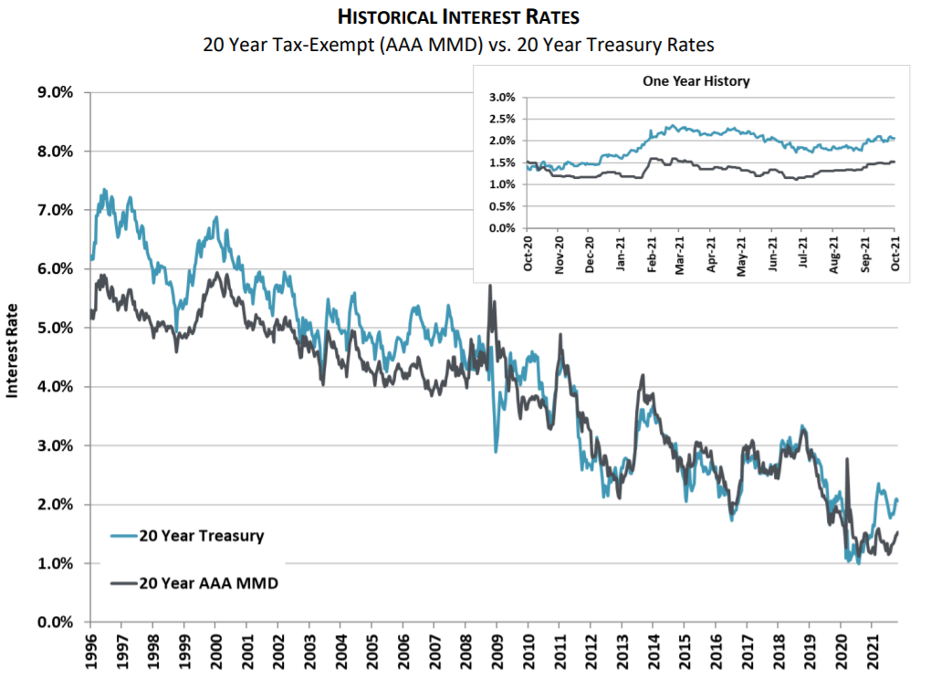
Historical Interest Rates
20 Year Tax-Exempt vs. 20 Year Treasury Rates

Slide 19
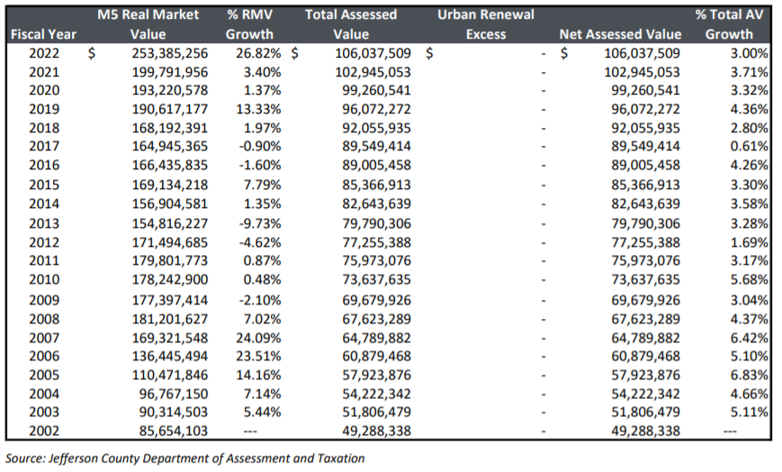
Historical Valuation Trends
Black Butte School District No. 41

Slide 20
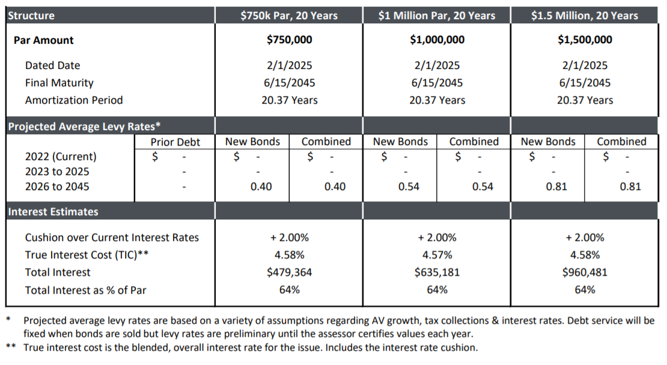
Summary of Scenarios

Slide 21
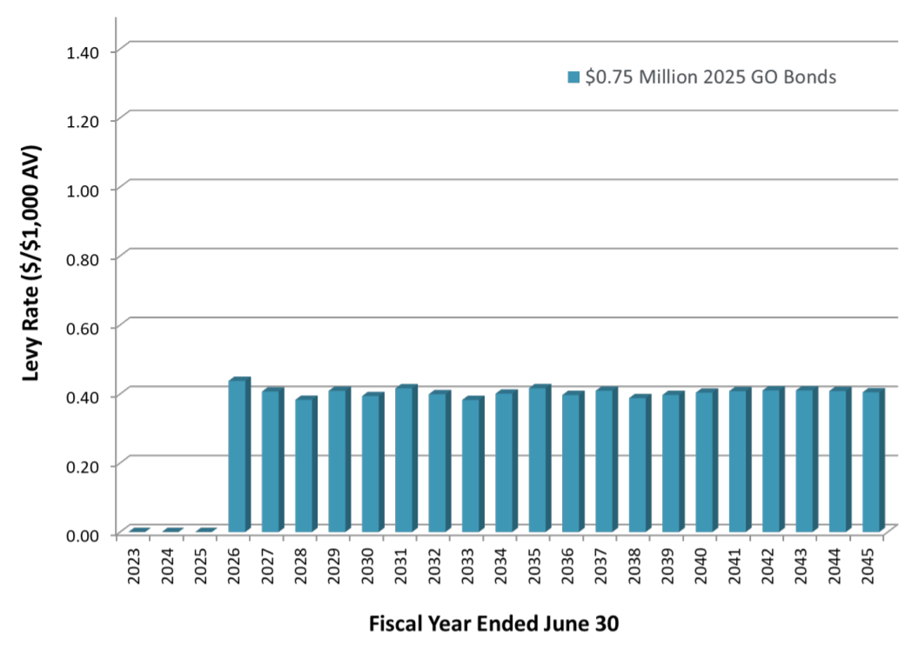
GO Bonds Series 2025 $750,000 Par Amount

Slide 22
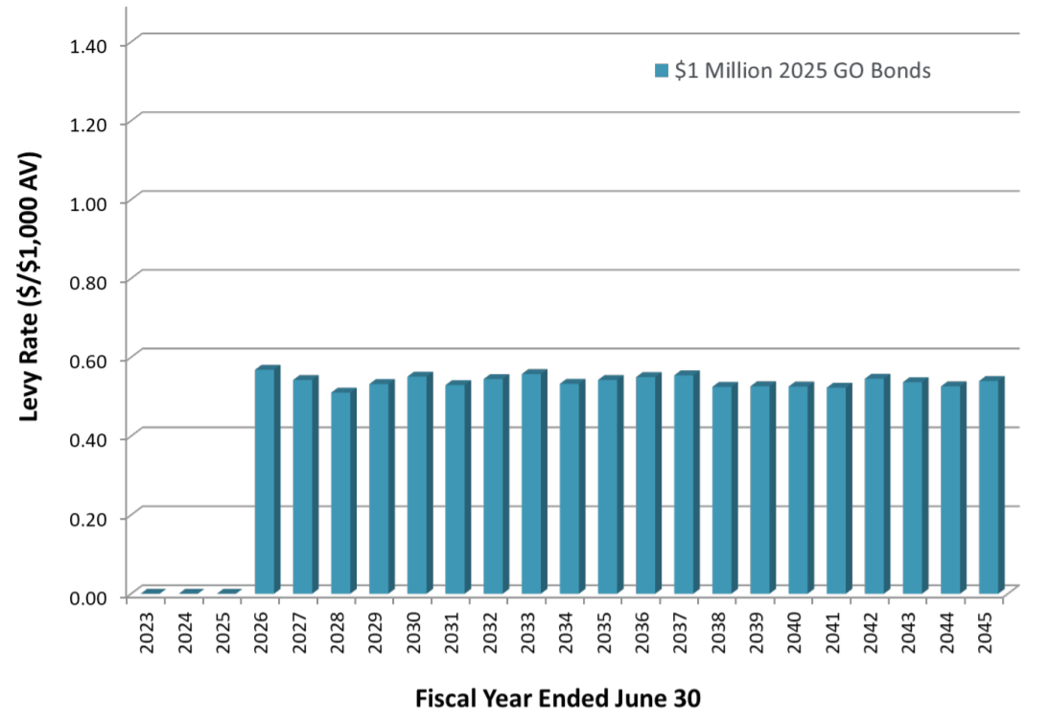
GO Bonds Series 2025 $1,000,000 Par Amount

Slide 23
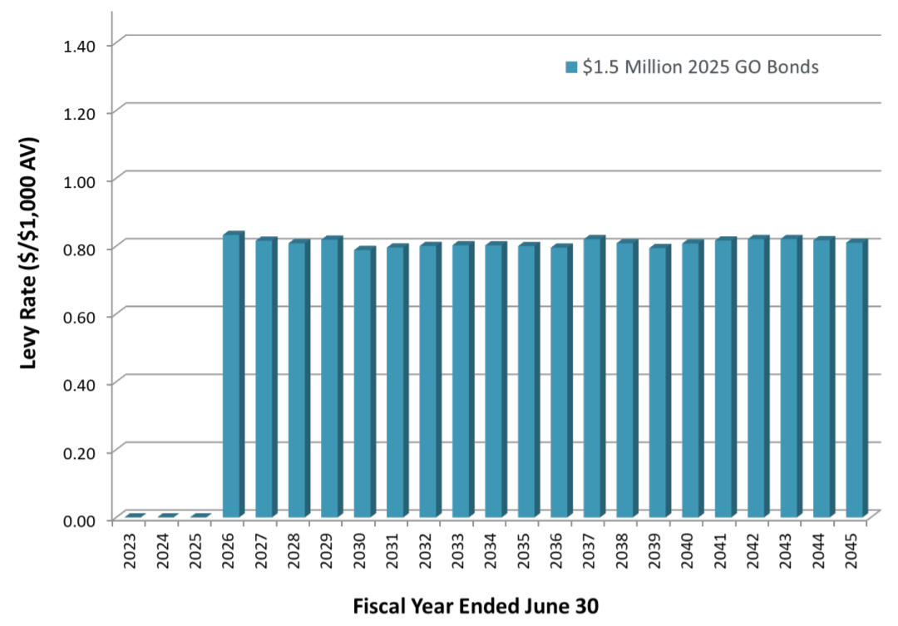
GO Bonds Series 2025 $1,500,000 Par Amount

Slide 24
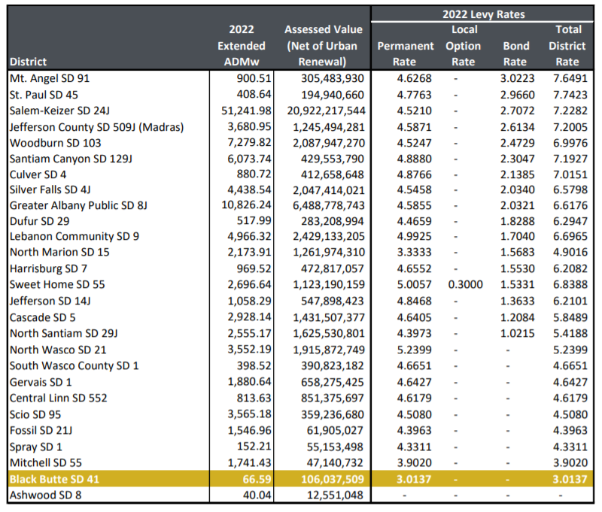
School District Levy Rates in Neighboring Counties

Slide 25
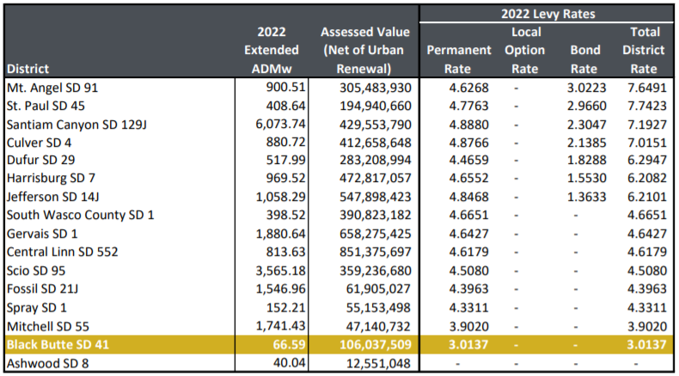
School District Levy Rates in Neighboring Counties with less than $1B in Assessed Value

Slide 26
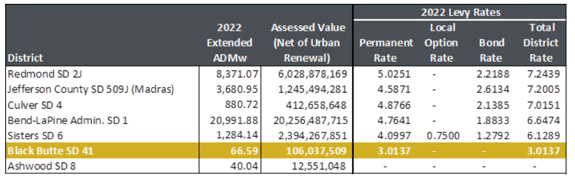
School District Levy Rates in Neighboring Districts

Slide 27
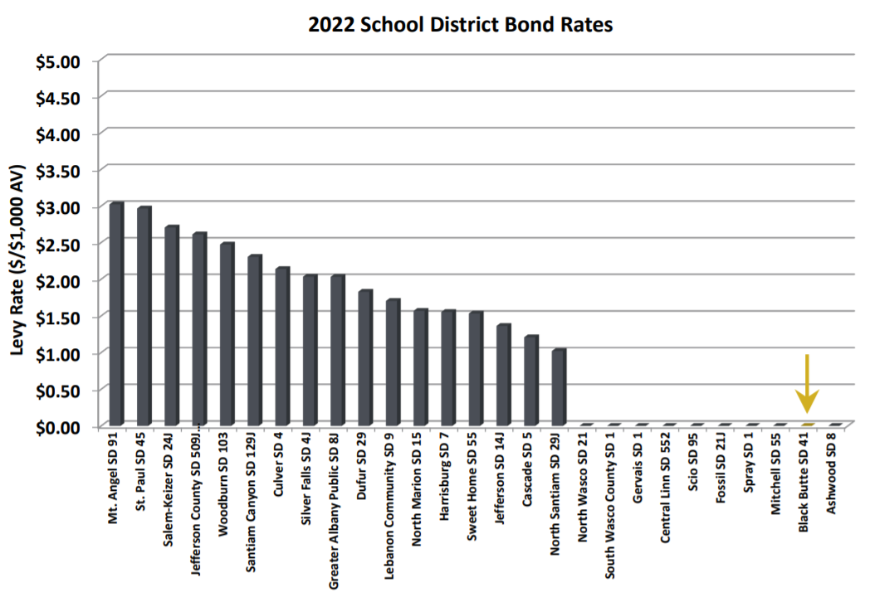
Comparative School District Bond Rates

Slide 28

Questions?

Slide 29
Contact Information
Piper Sandler
Carol Samuels, Managing Director
(503) 275-8301 - carol.samuels@psc.com
Lauren MacMillan, Senior Vice President
(503) 275-8302 - lauren.macmillan@psc.com
Brendan Watkins, Assistant Vice President
(503) 275-8307 – brendan.watkins@psc.com

Slide 30
Disclosure
      Piper Sandler is providing the information contained herein for discussion purposes only in anticipation of being engaged to serve as underwriter or placement agent on a future transaction and not as a financial advisor or municipal advisor. In providing the information contained herein, Piper Sandler is not recommending an action to you and the information provided herein is not intended to be and should not be construed as a “recommendation” or “advice” within the meaning of Section 15B of the Securities Exchange Act of 1934. Piper Sandler is not acting as an advisor to you and does not owe a fiduciary duty pursuant to Section 15B of the Exchange Act or under any state law to you with respect to the information and material contained in this communication. As an underwriter or placement agent, Piper Sandler’s primary role is to purchase or arrange for the placement of securities with a view to distribution in an arm’s-length commercial transaction, is acting for its own interests and has financial and other interests that differ from your interests. You should discuss any information and material contained in this communication with any and all internal or external advisors and experts that you deem appropriate before acting on this information or material.
      The information contained herein may include hypothetical interest rates or interest rate savings for a potential refunding. Interest rates used herein take into consideration conditions in today’s market and other factual information such as credit rating, geographic location and market sector. Interest rates described herein should not be viewed as rates that Piper Sandler expects to achieve for you should we be selected to act as your underwriter or placement agent. Information about interest rates and terms for SLGs is based on current publically available information and treasury or agency rates for open-market escrows are based on current market interest rates for these types of credits and should not be seen as costs or rates that Piper Sandler could achieve for you should we be selected to act as your underwriter or placement agent. More particularized information and analysis may be provided after you have engaged Piper Sandler as an underwriter or placement agent or under certain other exceptions as describe in the Section 15B of the Exchange Act.
      Piper Sandler Companies (NYSE: PIPR) is a leading investment bank and institutional securities firm driven to help clients Realize the Power of Partnership®. Securities brokerage and investment banking services are offered in the U.S. through Piper Sandler & Co., member SIPC and FINRA; in Europe through Piper Sandler Ltd., authorized and regulated by the U.K. Financial Conduct Authority; and in Hong Kong through Piper Sandler Hong Kong Ltd., authorized and regulated by the Securities and Futures Commission. Asset management products and services are offered through separate investment advisory affiliates.
      © 2020 Piper Sandler Companies. 800 Nicollet Mall, Minneapolis, Minnesota 55402-7036

